Slide 2
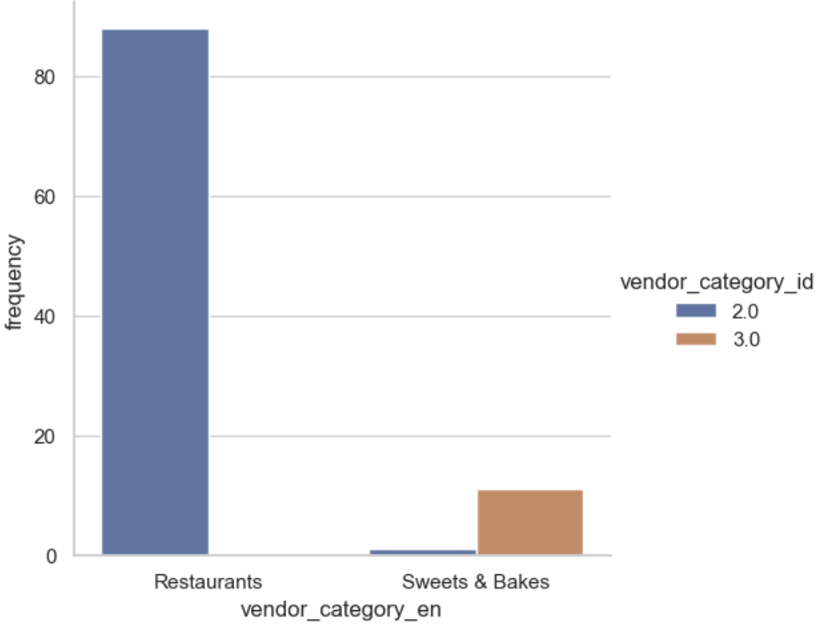
Vendor ID and Vendor Category Chart
Notes:
There is a high chance that one of the Sweets & Bakes was given a wrong category id. This can be changed to the id of the majority Sweets & Bakes
There are two vendor_category_id. Id = 2 represents restuarants and Id = 3 represents Bakes & Sweets

Slide 3
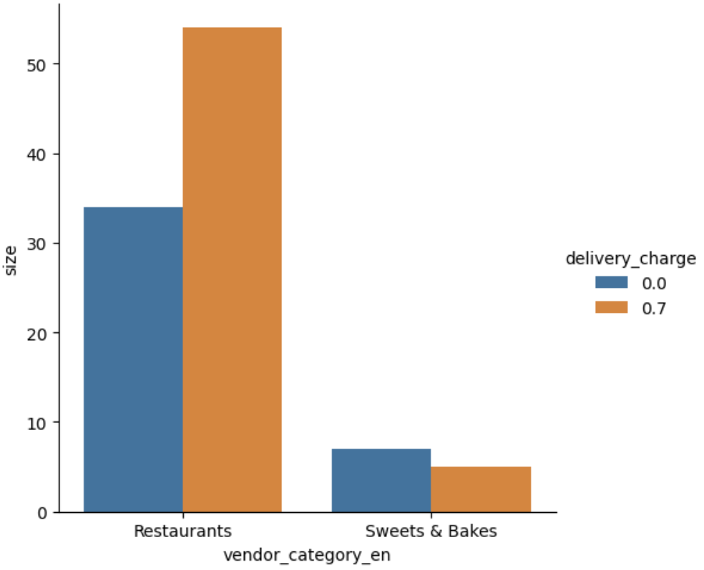
Vendor Category and Delivery Charge Chart
Notes:
Among Restaurants and Bakes & Sweets, 61% of Restaurants charge for delivery of food. 29% of Bakes & Sweets have a delivery fee

Slide 4
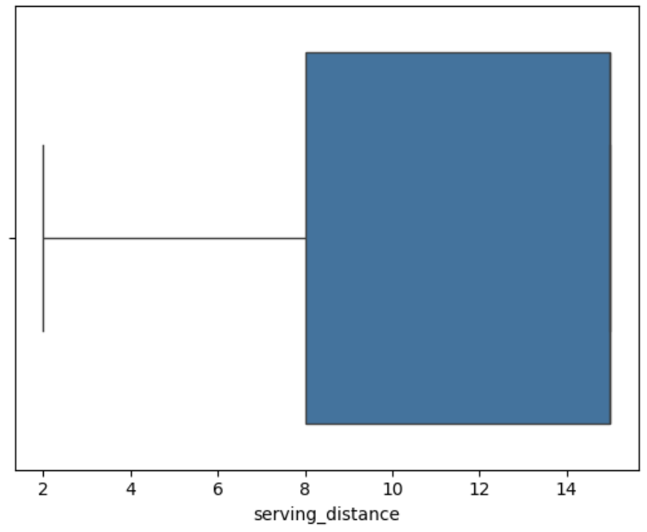
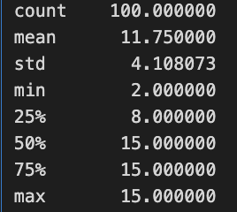
Serving distance
Notes:
57% of vendors have a serving distance of maximum 15km. No vendor provides a serving distnace of more than 15km

Slide 5
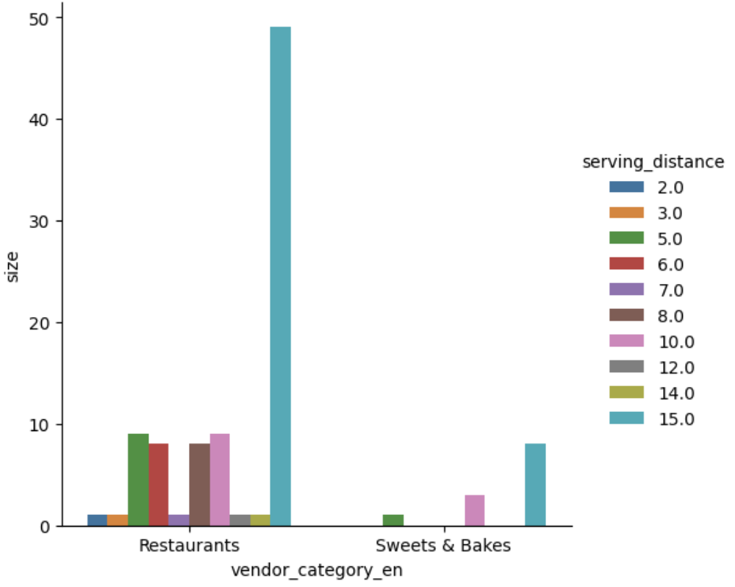
Vendor Category and Serving Distance Chart
Notes:
Irrespective of the type of vendor, majority of the vendors offers a serving diatnce of 15kms followeed by 10kms and 5kms

Slide 6
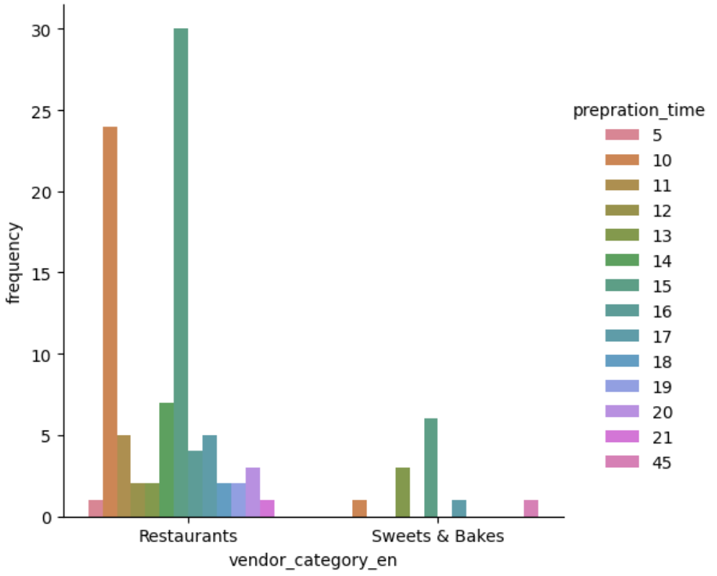
Vendor Category and Preparation Time Chart
Notes:
Prepration time varies between 5 to 45 minutes
For both Restauarants and Bakes&Sweets, 15minutes time is taken by most of the vendors
This is followed by 10 minutes for restuarants and 13 minutes for Bakes&Sweets
Resturants prepratiom time ranges from 5 to 21 minutes and 10 to 45 minutes for Bakes&Sweets

Slide 7
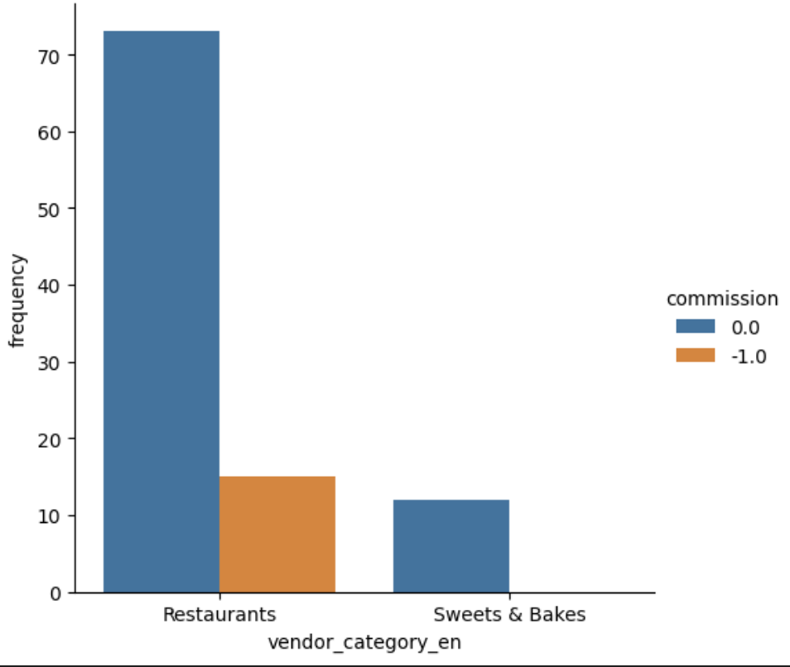
Vendor Category and Commission Chart
Notes:
85% of vendors do not take commission
12% of vendors who take commission are Restauarants

Slide 8
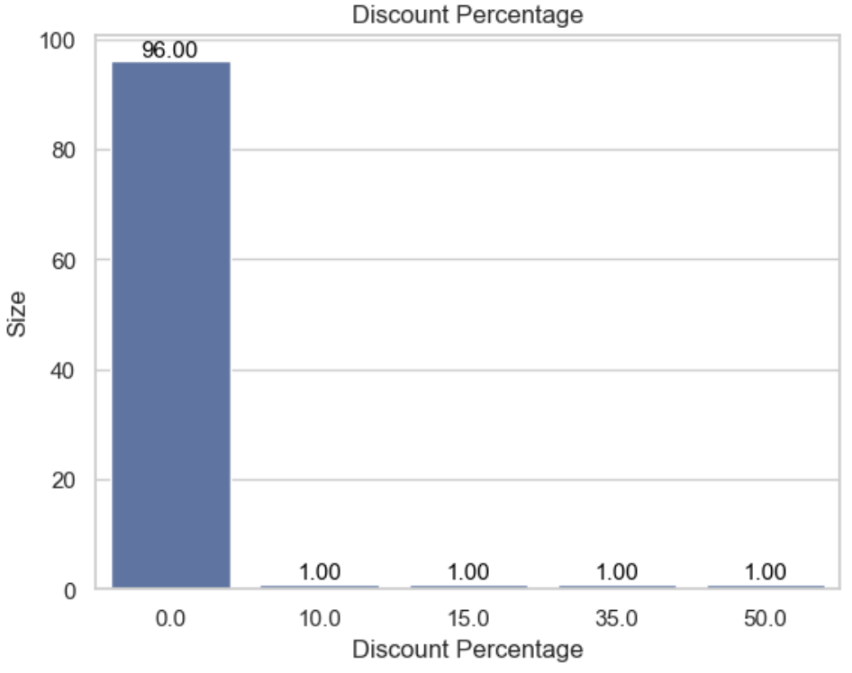
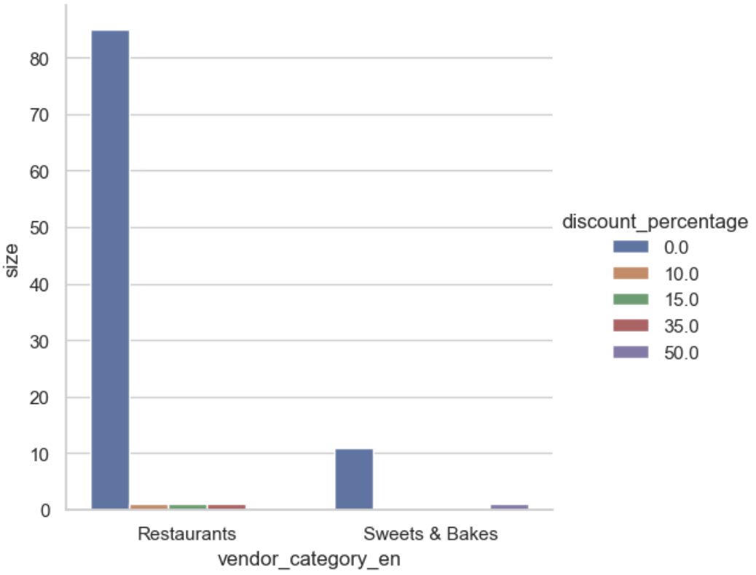
Vendor category and discount percentage
Notes:
Among the 4% of vendors that provide discounts, 3% of vendors are Restauarants and 1% of vendor is Bakes&Sweets
96% of vendors, do not provide any discount
3% of Restaurants provide a discount of either 10 , 15 or 30 %
1% of Bakes&Sweets provide a discount of 50%

Slide 9
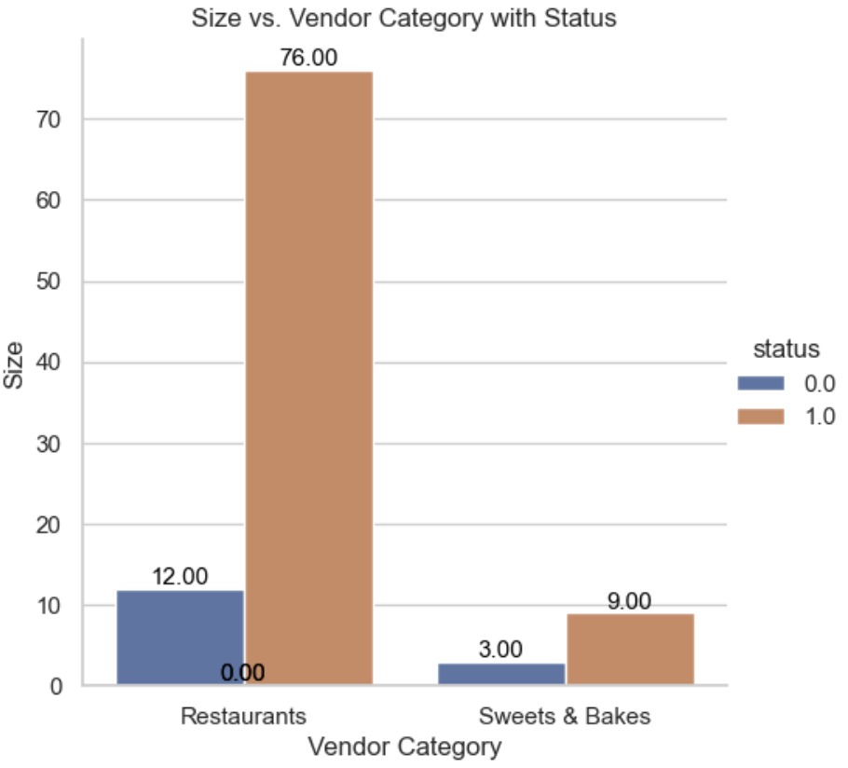
Vendor category and status
Notes:
From the above plot, it can be seen that, the number of vendors that have a status = 0 , is equal to the number of vendors that has is_open = 0.
Let's further anlayse if the restusrants that have is_open = 0 also have status = 0

Slide 10
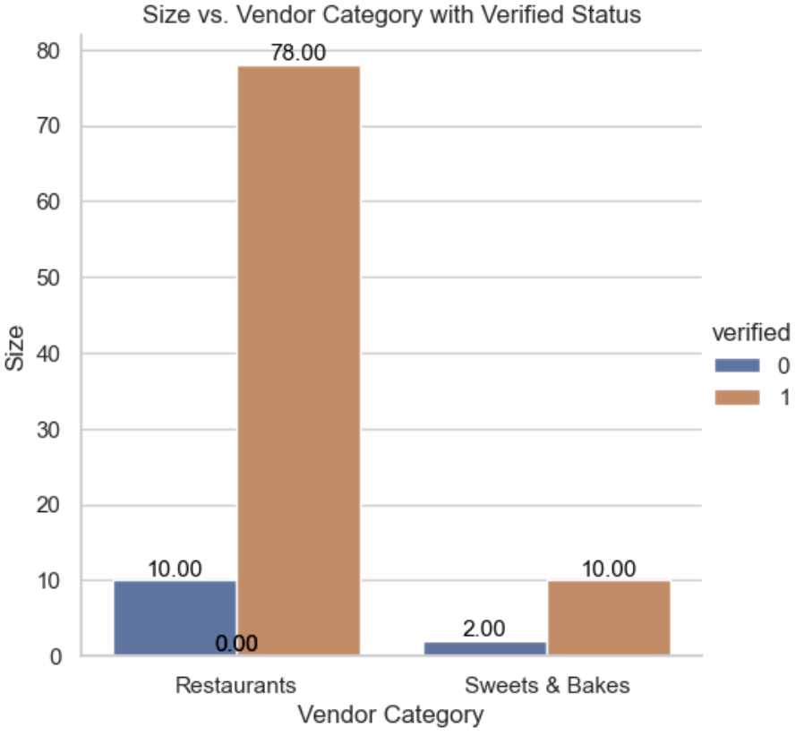
Vendor category and verified

Slide 11
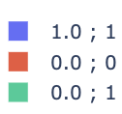
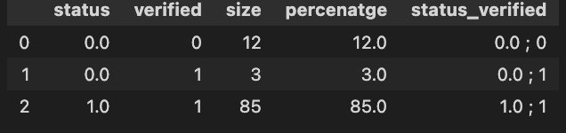
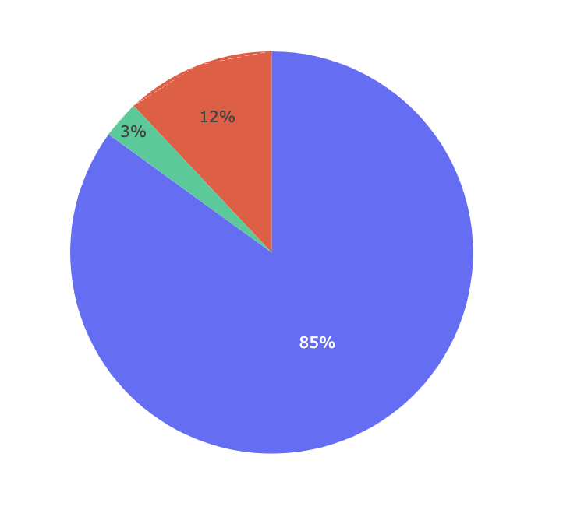
Status and Verified Chart
Notes:
Out of the 15% of vendors whose account are not active, 12% of total vendors they neither verified there accounts nor active and only 3% verified,
85% of vendors have their account verified and active.

Slide 12
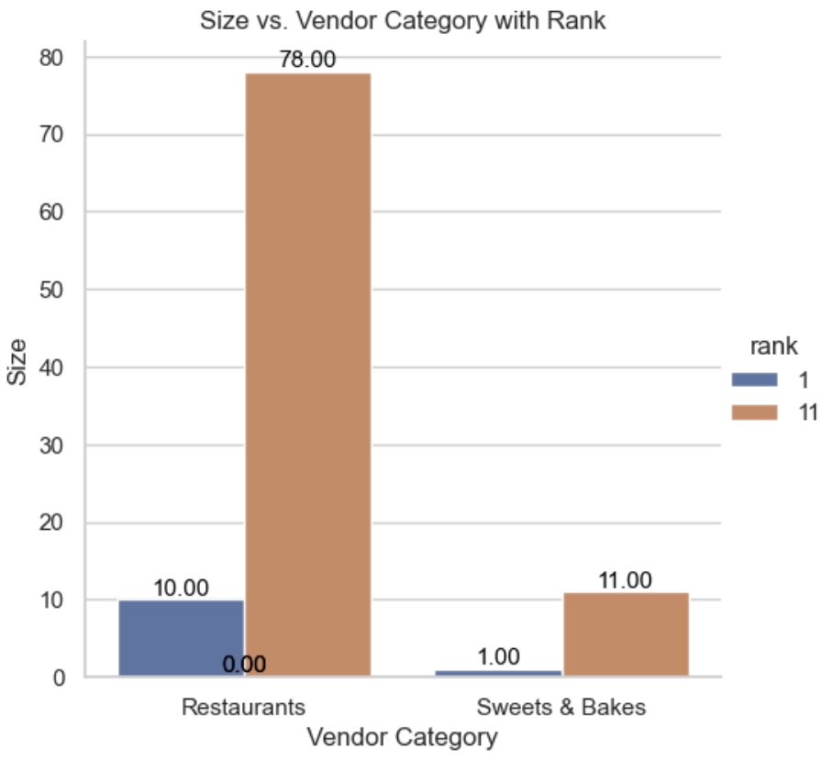
Size vs Vendor category with rank
Notes:
89% of vendors have a rank = 11
Restauarnts : 88% (78/88) are ranked 11
Sweets&Bakes : 92% (11/12) are ranked 11

Slide 13
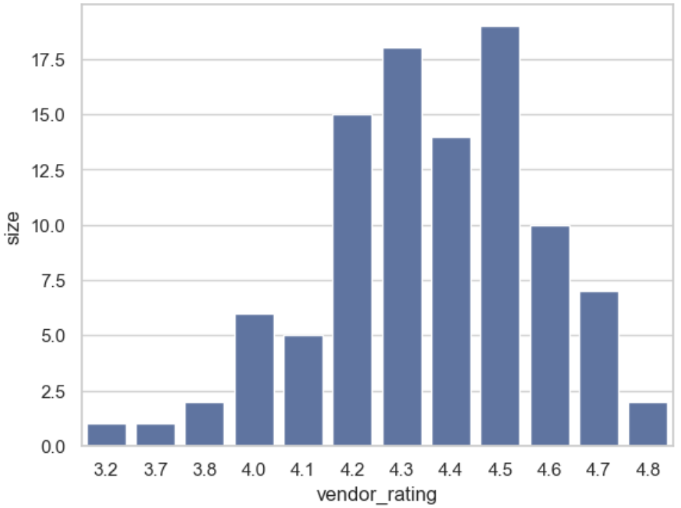
Vendor rating distribution

Slide 14
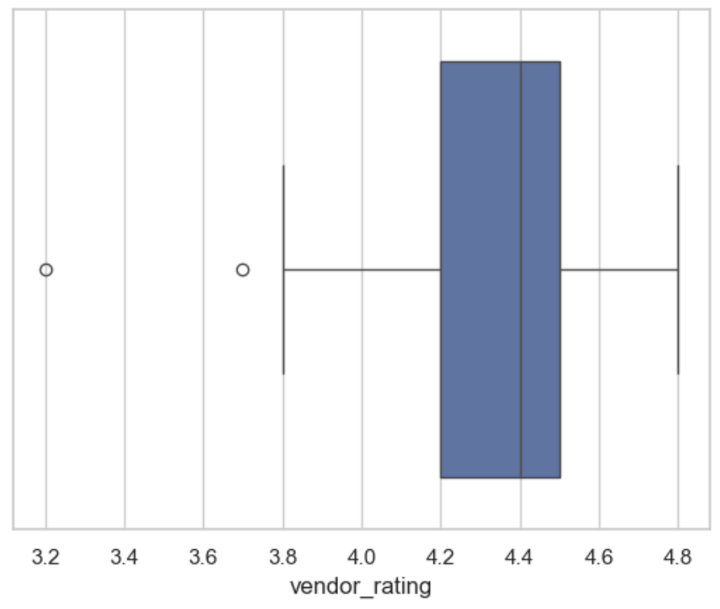
Vendor rating
Notes:
The rating of the vendors ranges from 3.2 to 4.8.
This implies that the rating scale used is 1-5
19% of vendors are rated 4.5 (mode)
2% of vendors are rated 4.8 (max)
1% of vendors are rated 3.2 (min)

Slide 15
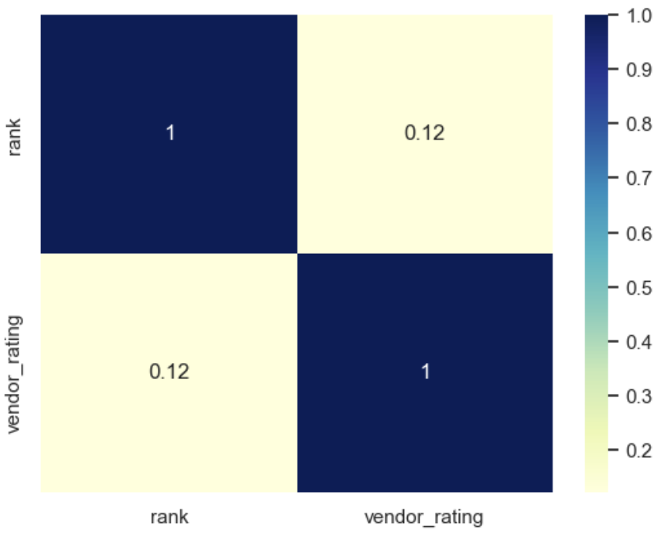
Correlation Matrix Of Vendor Rating And Rank
Notes:
There is not strong correlation between rank and vendor_rating
4.5 rating is the most common rating of the vendors.
The correlation between rank and vendor_rating is not strong. This may imply that the method of assigning a rank to avendor is highly dependnet on other features which may not be avaialable

Slide 16
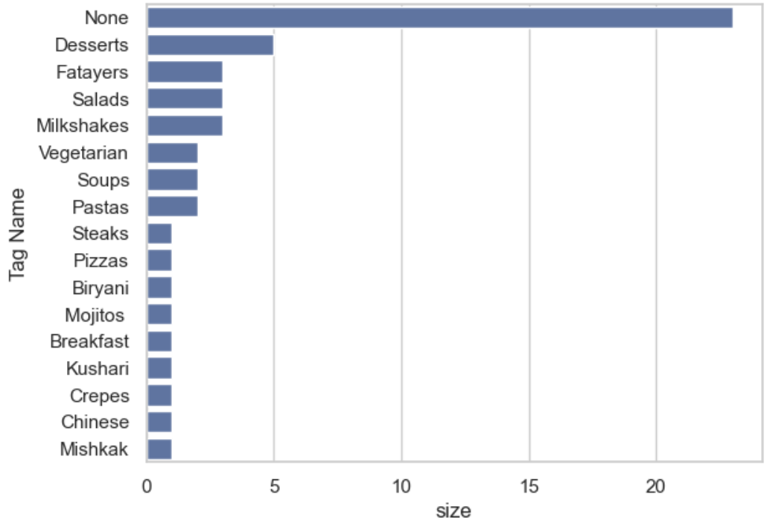
Tag name count
Notes:
There are 17 unique primary tag name. Desserts top the list with 44 vendors having it as its primary tag

Slide 17
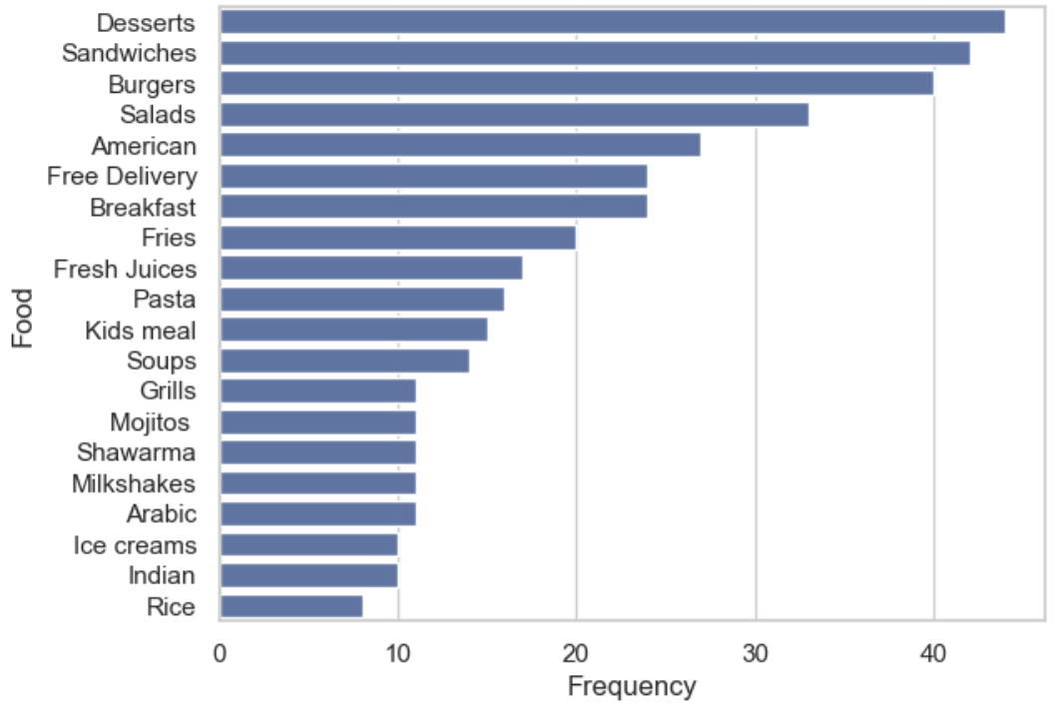
Food frequency

Slide 18
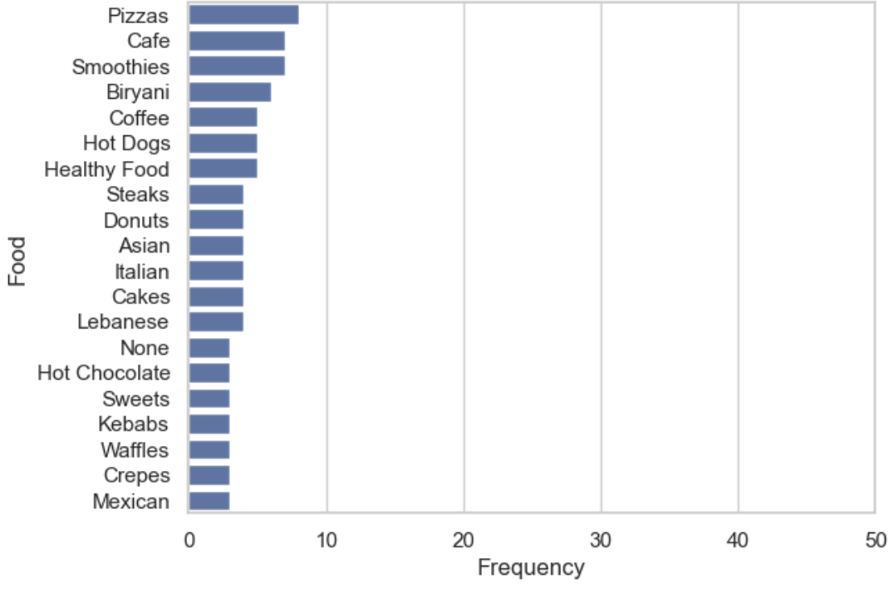
Food frequency

Slide 19
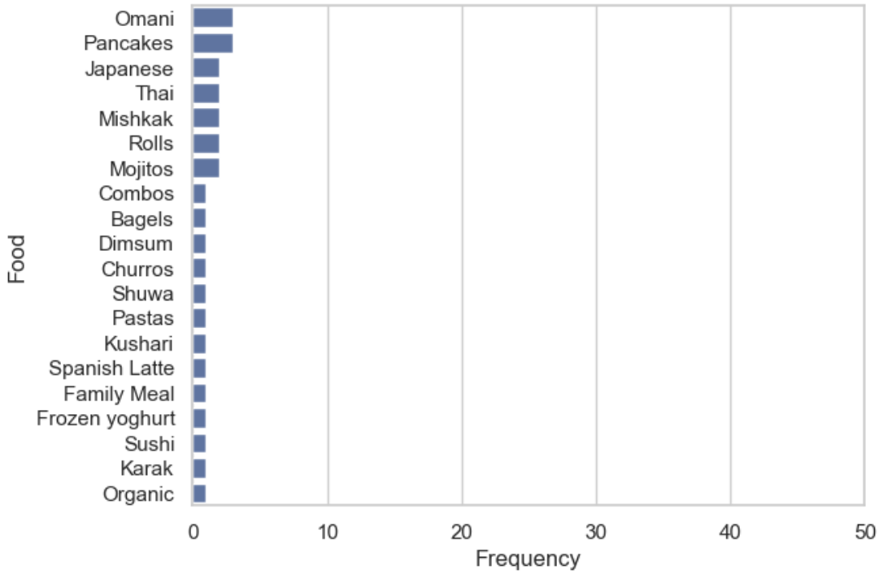
Food frequency

Slide 20
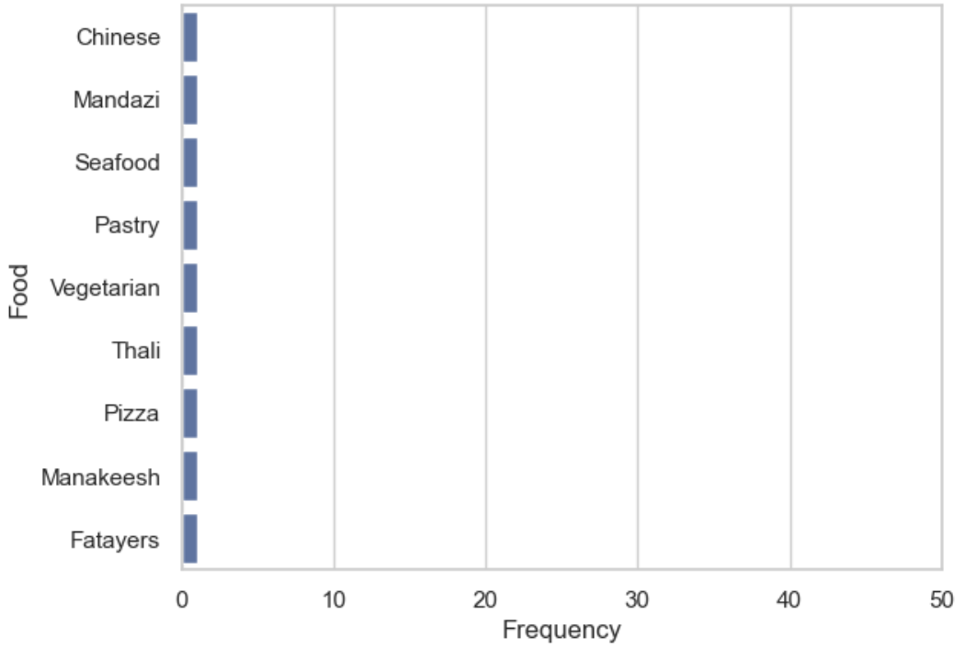
Food frequency
Notes:
There are 69 unqiue tag names among all the vendors. Desserts top the list. Free Delivery is also considered as a tag name for the vendors. Free Delivery comes 6th from the top.
There were only 17 vendors which had a valid primary key
There are 69 unique dishes offered by combining all the vendors
One of the tag name is Free Delievery, with 24 vendors having it as part of their tag. Hence there are 68 dishes
From delievery_charge, 41 vendors provide free delivery. Hence the 24 vendors who have a tag name of Free Delivery can be checked against the 41 vendors obtained in the delievry_charge feature

Slide 21
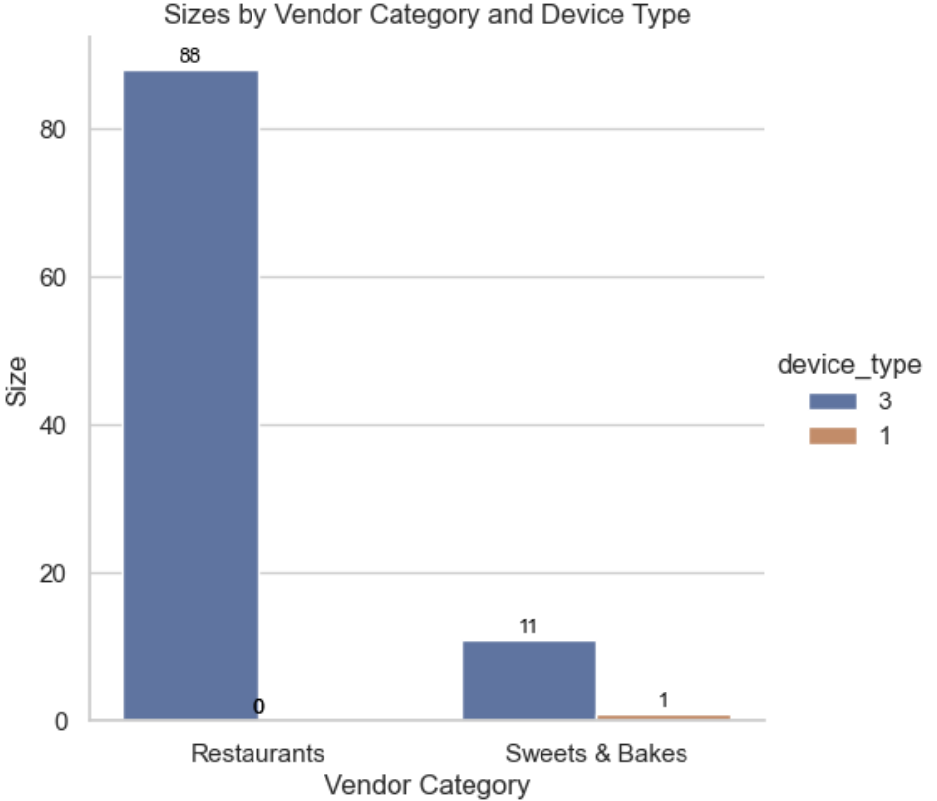
Size by category and device type
Notes:
Out of the 99 vendors who use device type = 3 , 88 vendors are Restuarants and 11 vendors are Sweet&Bakes

Slide 22
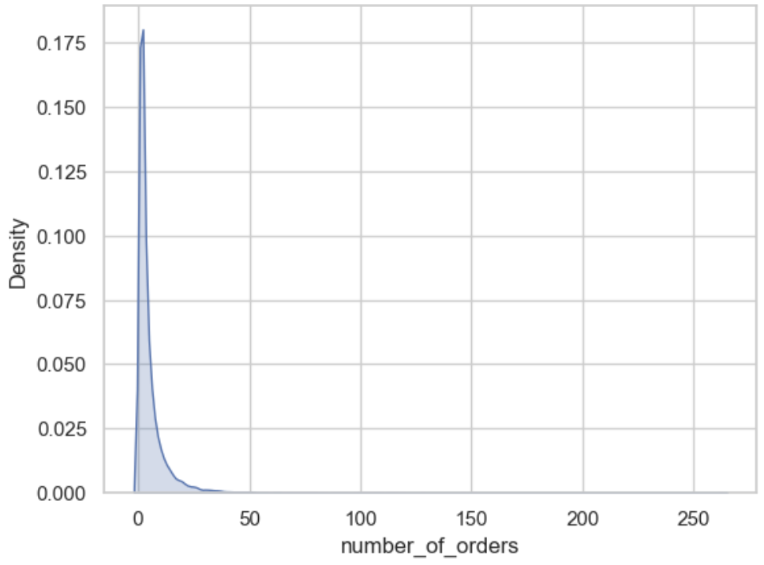
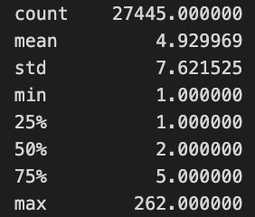
Orders count
Notes:
27445 customers have placed an order out of around 35K customers
50% of the customers have made 2 orders
75% of customers have made 5 orders

Slide 23
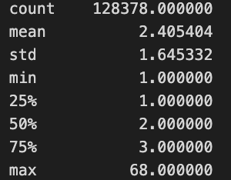
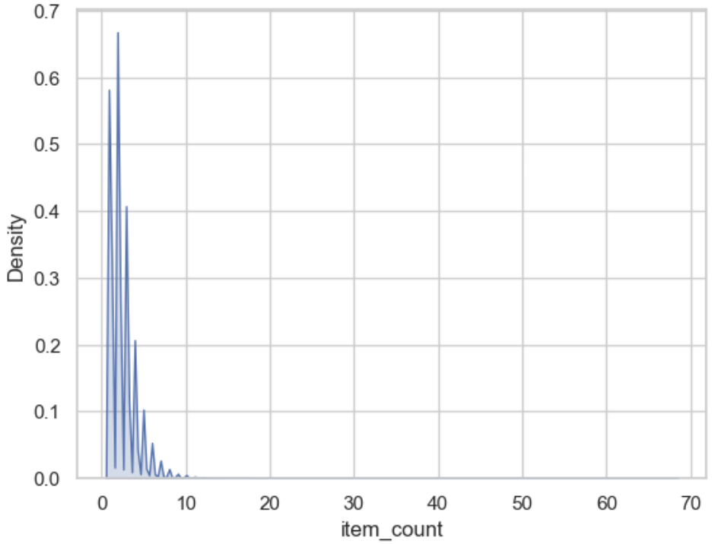
Item count
Notes:
Around 41K orders of the customers had 2 items in the order (50% of the orders)
75% of customers have made an order of 3 times
6925 orders do not have the number of items ordered

Slide 24
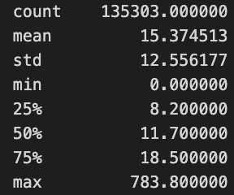
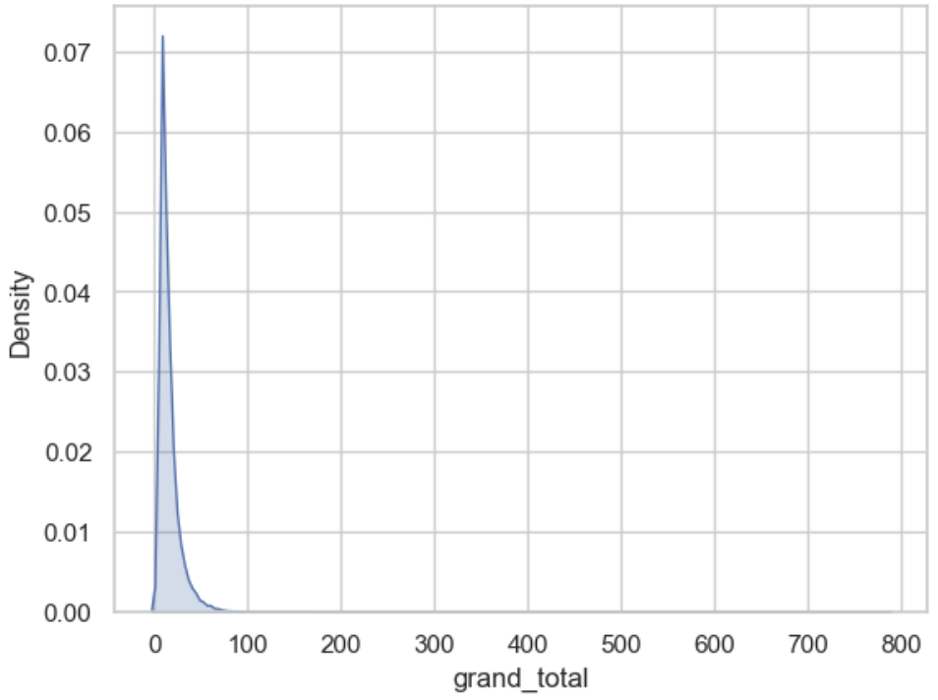
Count of grand total
Notes:
On an average a customer spends 15 Omani Radi
50% of customers spends 11.7 Omani Radi
There are no missing values

Slide 25
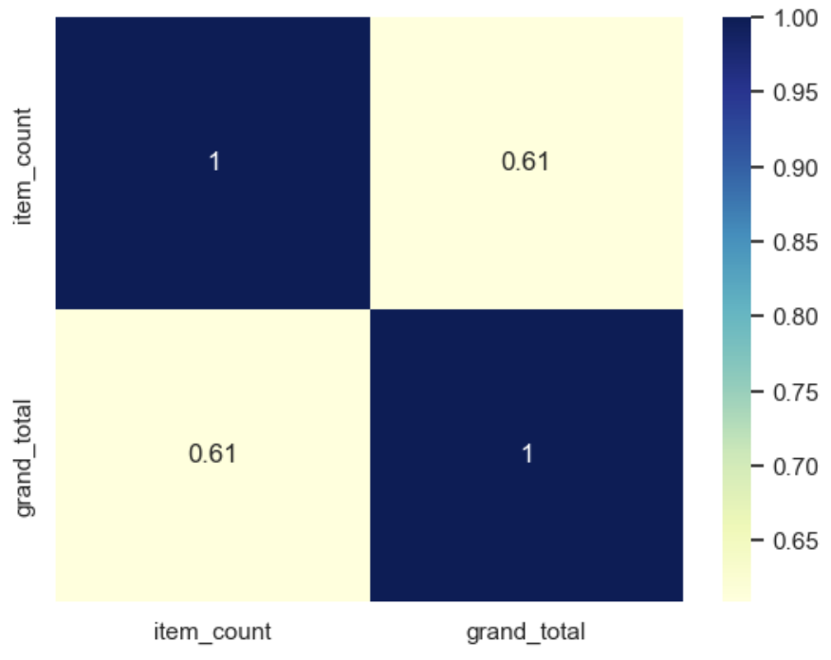
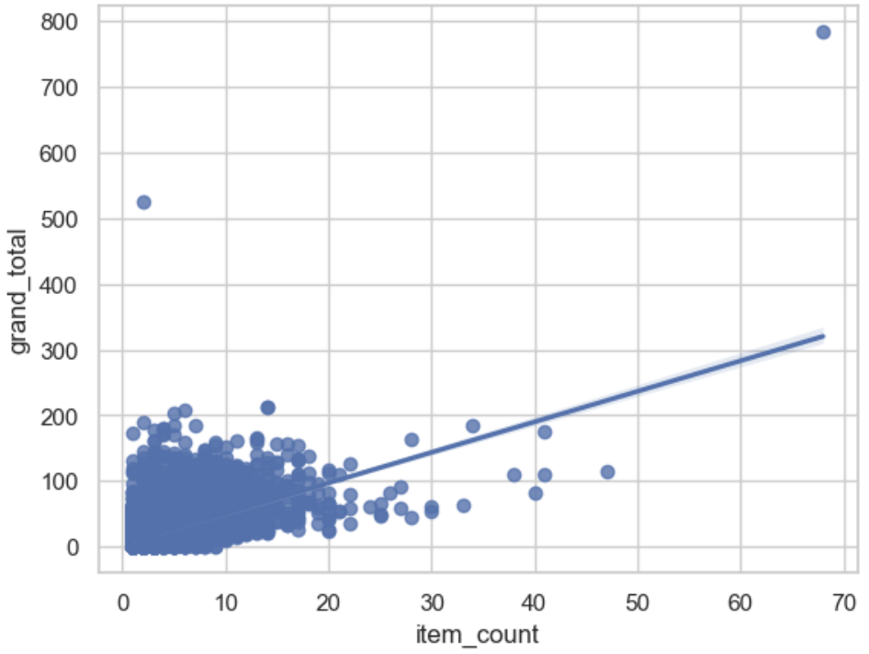
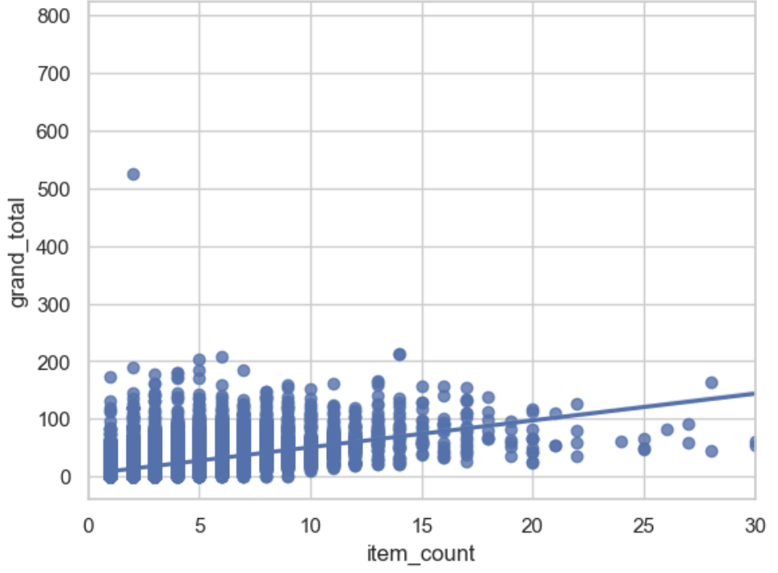
Item and grand total count
Notes:
The correlation between item_count and grand_total is 0.61
The coefficient of determination is 0.3721
From correlation value, we can infer that there the strength of the relationship between item_count and grand_total is not very strong and from coefficient of determination, only 37% of the change in grand_total can be explained by number of items (item_count)
50% of the customers pay 11.7 Omani Radi
There is some degree of depedency between item_count and grand_total with 37% of the variance in one variable that is explainable by the other variable

Slide 26
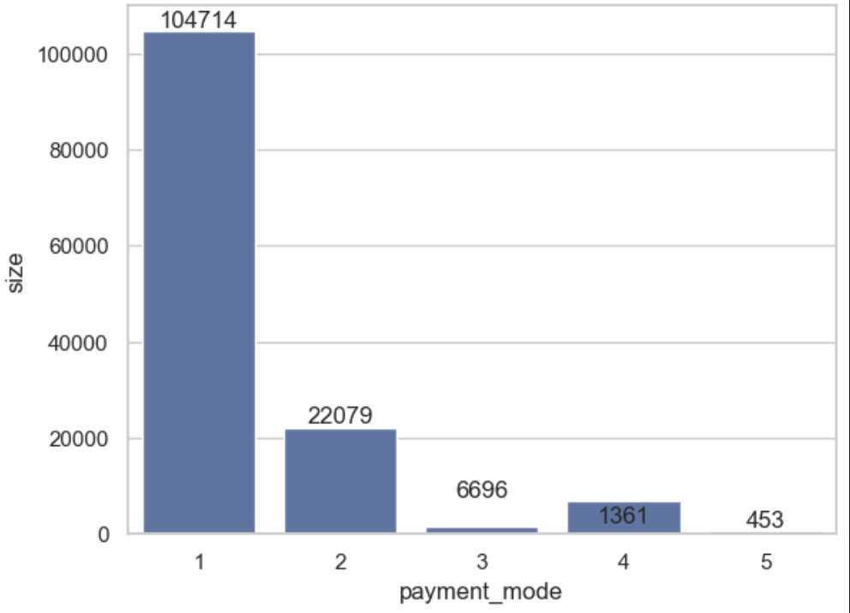
Count of payment method
Notes:
There are 5 modes to make the payment
Payment mode is used the most, followed by payment mode 2,4,3 and 5

Slide 27
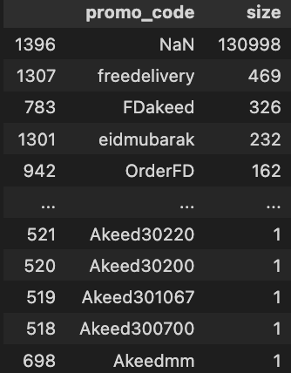
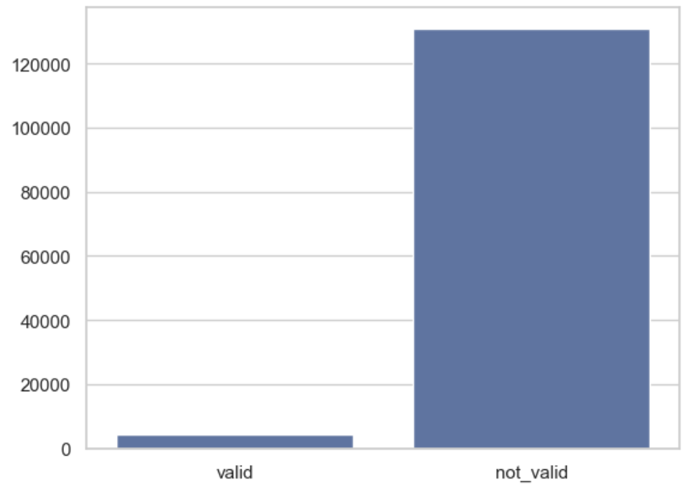
Promo code count
Notes:
Even though, Free Delivery tops the list of valid promo codes, it only contributes to 3.18% of the valid promo code
96.82% of customers, do not use any promo code or 96.82% of the orders do not have a promo code option

Slide 28
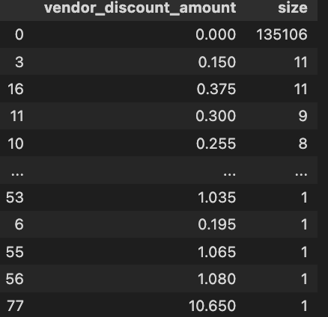
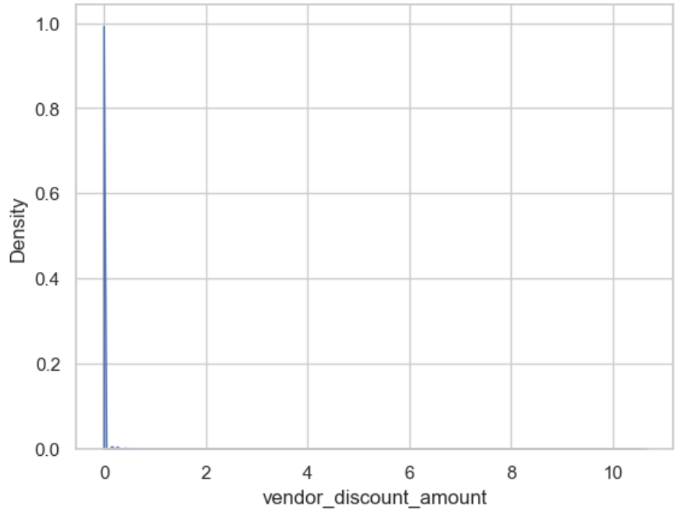
Vendor discount amount count
Notes:
For less than < 1% of the orders, the vendors provide a discount

Slide 29
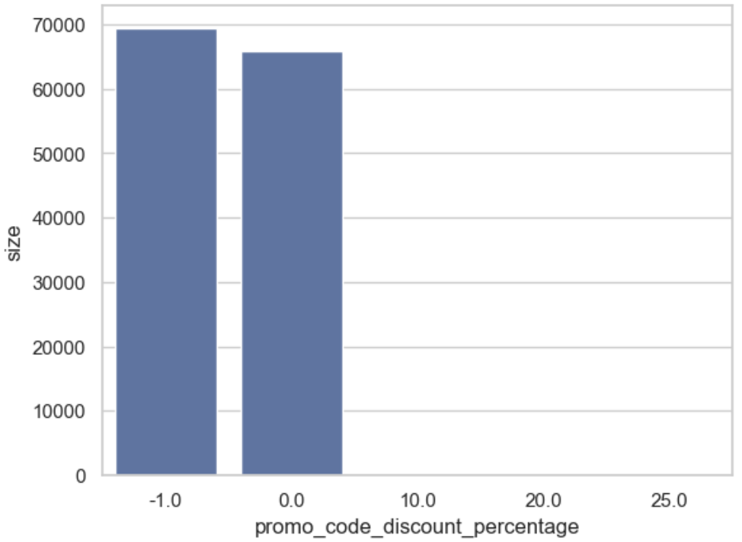
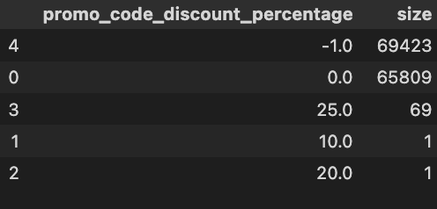
Promo code discount percentage count
Notes:
The percantage of NaN discount percentage is 51% and zero discount percentage is 47%. This is roughly 99% percenatge.
Only 0.05% have a non zero discount percenatge
These values are very close to the vendor_discount_amount

Slide 30
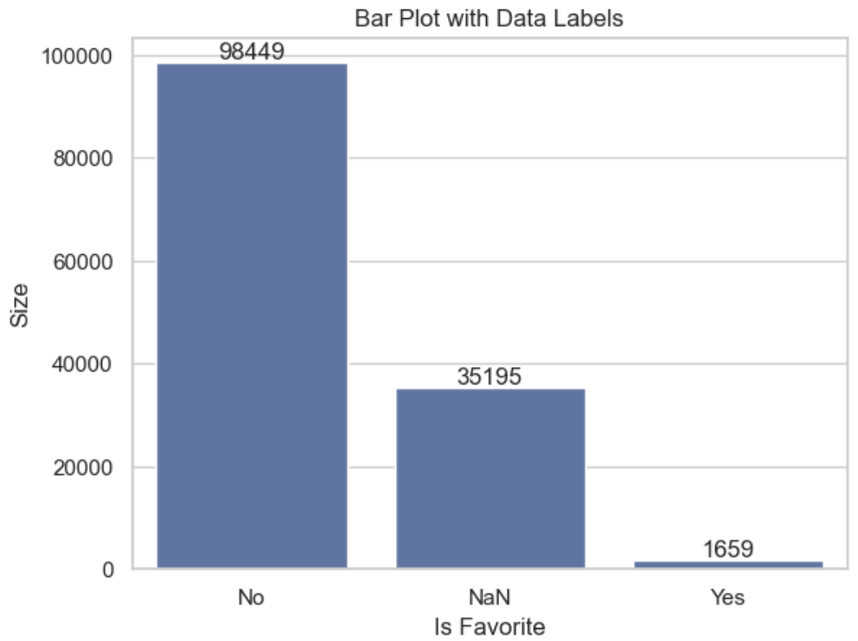
Is favorite count
Notes:
There is only a very small percenatge of customers(orders) who finds a vendor that they really like
Majority of the cutsomers (orders) do not have a favourite vendor

Slide 31
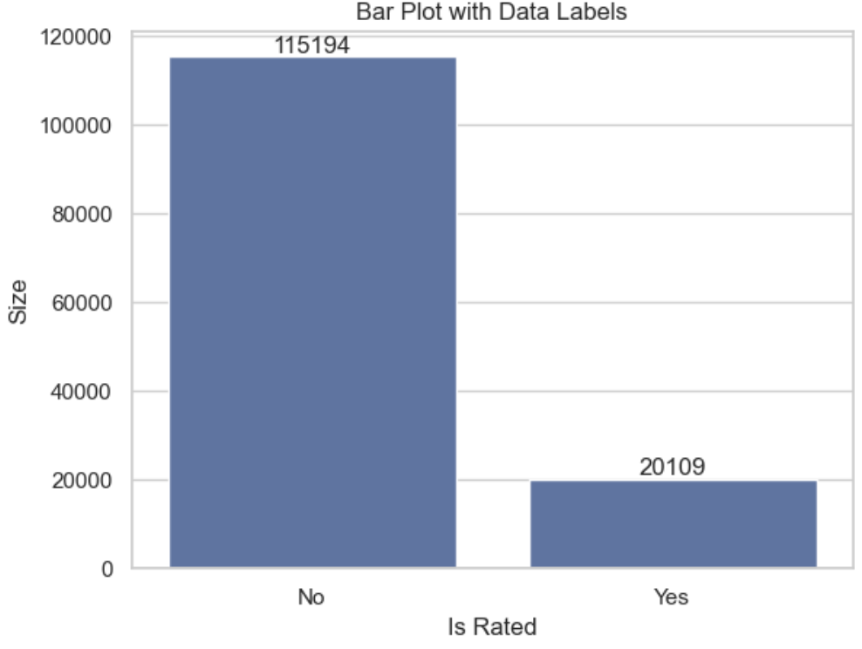
Is rated count
Notes:
Majority of the customers (orders) have not rated the vendor

Slide 32
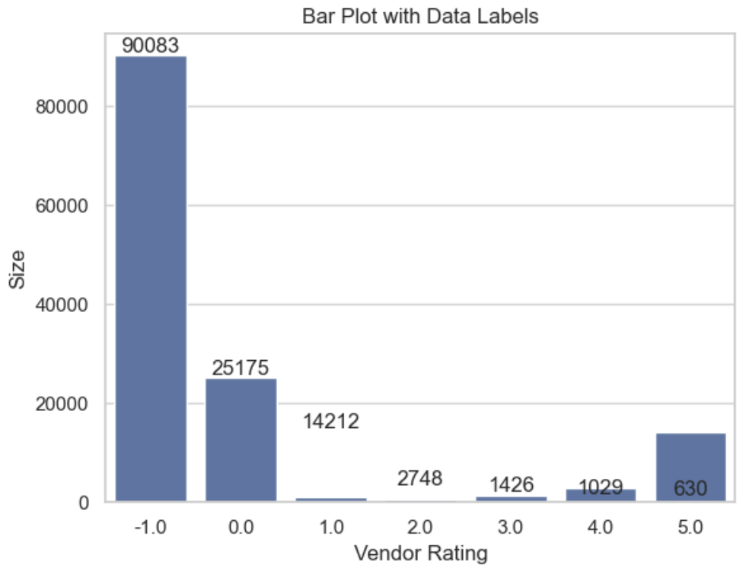
Vendor rating count
Notes:
Majority of the customers (orders) have not given a rating to the vendor. This is followed by a rating of 0 for the vendors and then a rating of 5

Slide 33
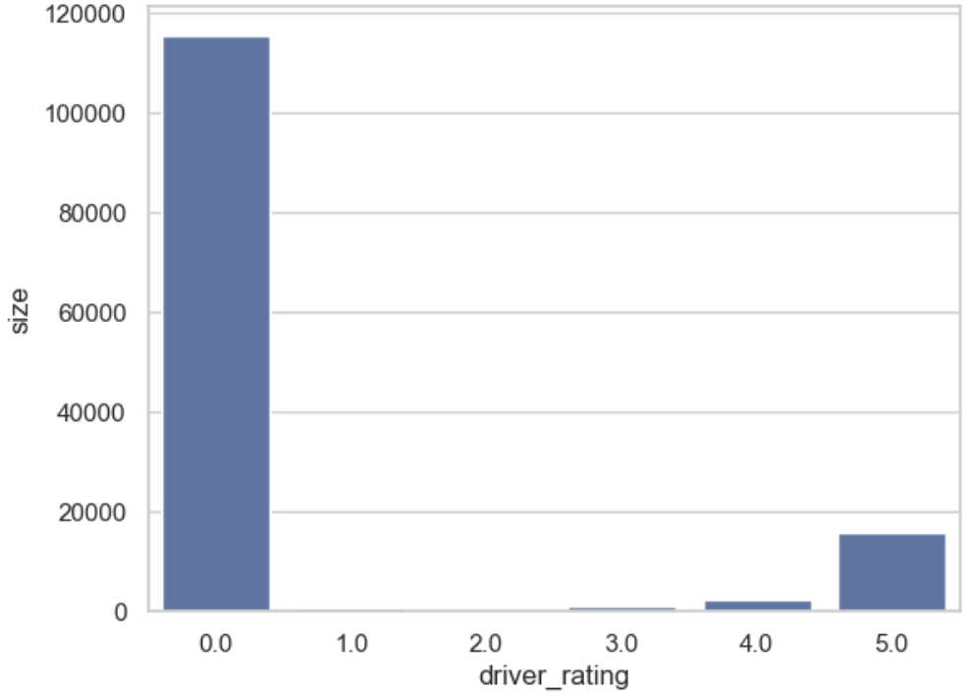
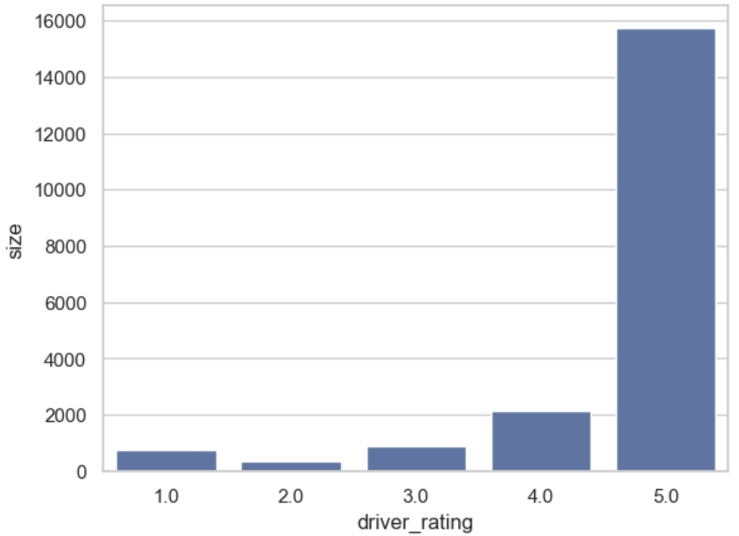
Driver rating count
Notes:
Majority of the customers have given a drive rating of 0. This is followed by a 5 star rating

Slide 34
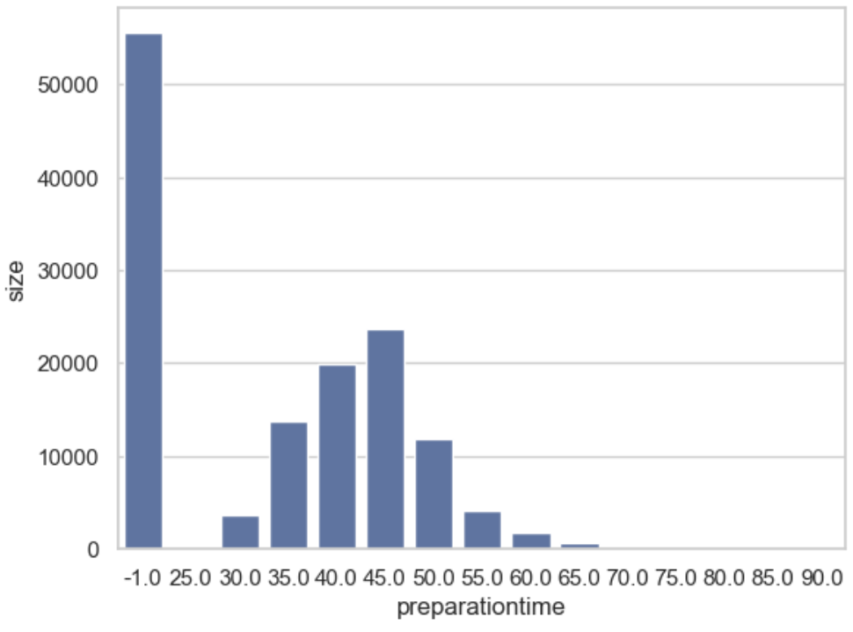
Preparation time count
Notes:
Excluding the missing prepration time (time =-1), most of the orders take 45 minutes with a mximum time of 90 minutes

Slide 35
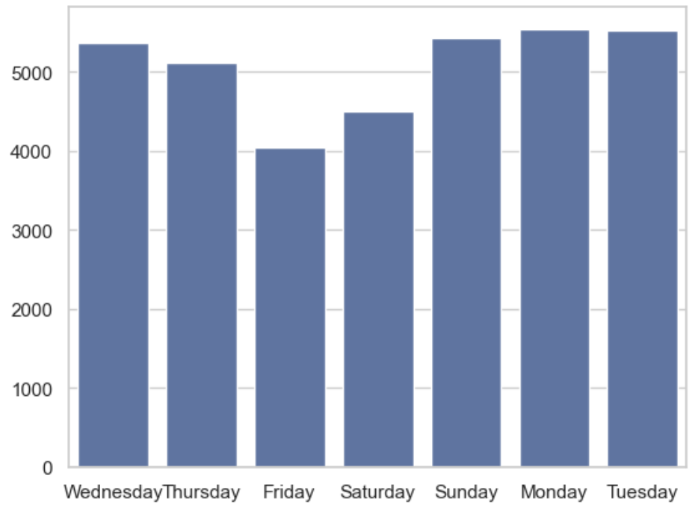
Number of Orders During the Week
Notes:
The day that has the minimum orders delieverd is on Friday and Saturday. This maybe due to the late openings of the vendors on Friday and Saturday

Slide 36
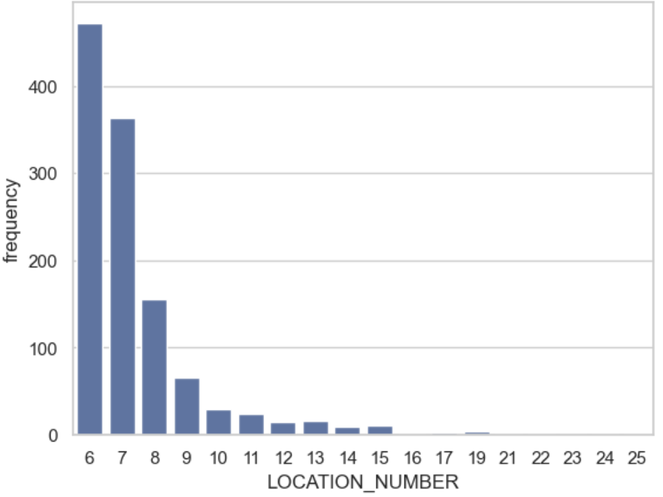
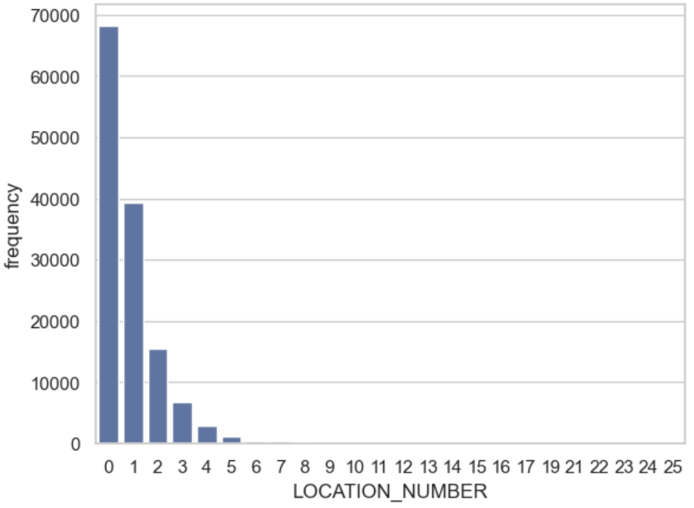
Location number count
Notes:
Orders have been made from 24 location numbers
There are no orders made from location numbers : 18,20,26,27,28 and 29
Majority of the orders are made from location number 0. This maybe due to the fact that a huge number of customers belong to location number 0

Slide 37
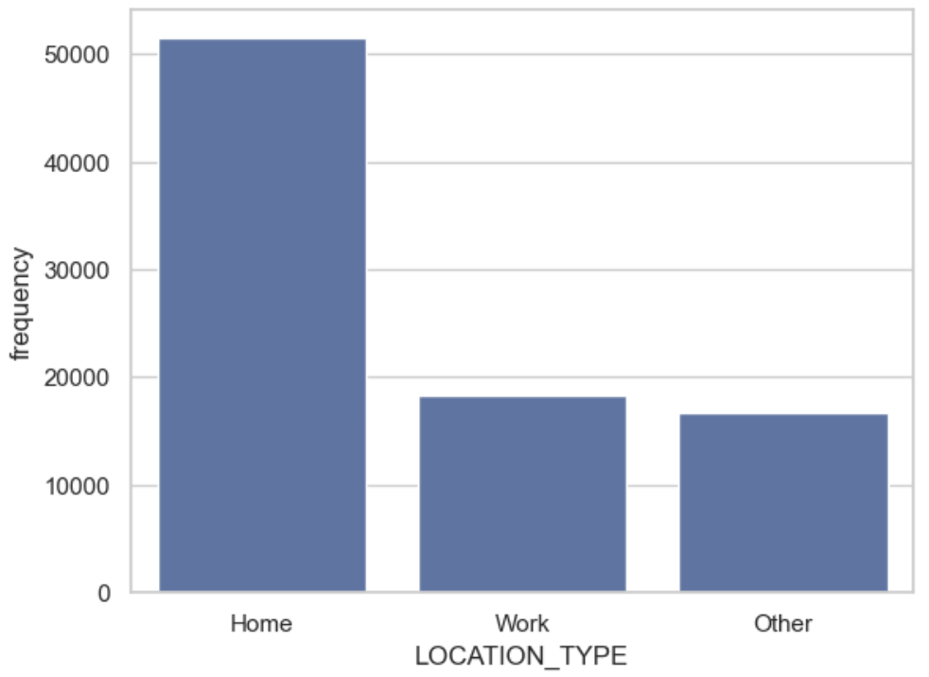
Location Type
Notes:
Majority of the orders are made from Home, followed by work and others respectively

